Slide 1
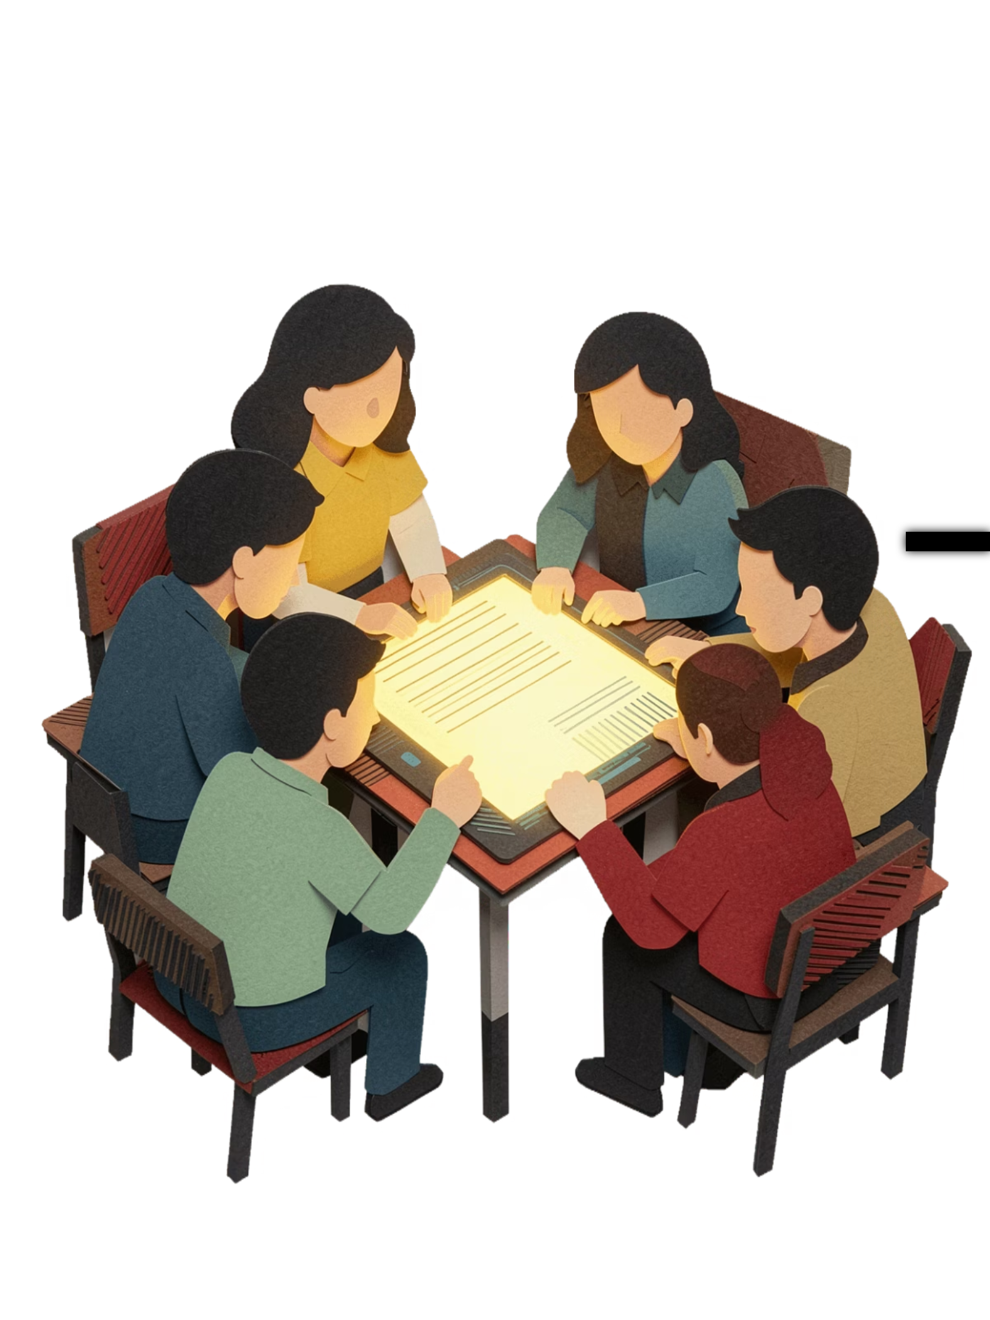
AI Foundations Program
CLASS 6–10 · 4 WEEKS · 1 HOUR/DAY
A month-long journey to make students comfortable, curious, and capable with AI tools — from homework help to creative projects and beyond.

Slide 2




What Students Will Achieve
By the end of four weeks, every student walks away with real, usable skills.
Understand AI Simply
Use AI for Schoolwork
Stay Safe Online
Study Smarter
Know what AI is, how it works, and where it shows up in everyday life.
Apply AI tools confidently for homework, projects, essays, and study prep.
Practise responsible, ethical AI use — including privacy and fact-checking.
Boost efficiency with AI-powered notes, flashcards, and revision strategies.

Slide 3
WEEK 1
Introduction to AI — Basics & Fun
Goal: Remove fear, build curiosity. Students explore what AI is and how to talk to it.
Day 1 — What is AI?
1
AI in daily life · "Is it AI or Human?" activity
2
Day 2 — Types of AI
Chatbots, image AI, voice AI · Live ChatGPT demo
Day 3 — Prompting Basics
3
Asking clear questions · Practise with real homework
4
Day 4 — AI for Fun
Story generation · Quiz creation · Joke making
Day 5 — AI Safety
5
No blind copying · Privacy basics · Responsible use

Slide 4
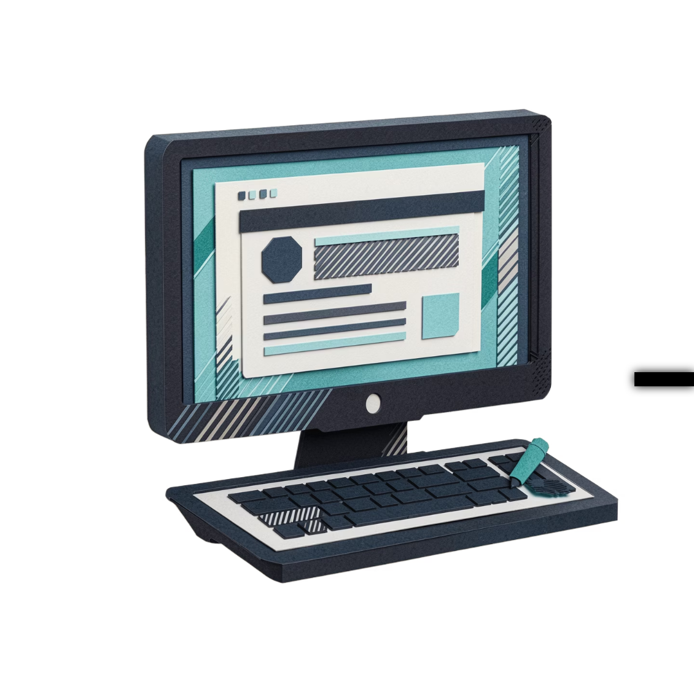
WEEK 2
AI for Academics 📚
Goal: Help students tackle daily schoolwork faster and smarter using AI as a study partner.
Day 6 — Homework Help
Day 7 — AI for Writing
Day 8 — Science Learning
Step-by-step explanations for maths and more
Essays, letters, summaries, grammar improvement
Simplify concepts, visualise diagrams conceptually
Day 9 — Language Learning
Day 10 — Study Assistant
Vocabulary building and translation assistance
AI-generated notes and custom flashcard sets

Slide 5

WEEK 3
Creativity + Projects 🎨
Goal: Make learning exciting — students create, imagine, and build with AI as their creative co-pilot.
Day 11 — AI Storytelling
Day 12 — AI Art Tools
Write imaginative stories with creative AI prompts
Intro to DALL·E — create images from text descriptions
Day 13 — AI Presentations
Days 14–15 — Mini Project
Build school project content and generate slide ideas
"My Dream School" or "Future City" — create and present with AI

Slide 6
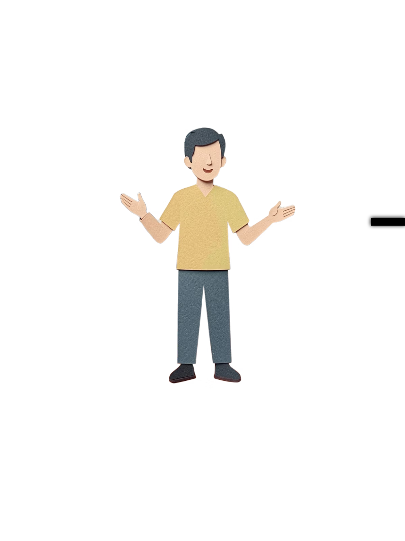




WEEK 4
Real-Life Skills & the Future 🚀
Goal: Build confidence and real-world understanding of where AI fits in careers and everyday problem-solving.
Day 16 — AI in Careers
Doctors, engineers, and artists already using AI daily
Days 17–18 — Smart Studying
Solve real problems · Build timetables · Revise smarter
Day 19 — AI Limitations
Recognise mistakes · Learn to fact-check AI outputs
Day 20 — Final Showcase
Students present their learning · Fun quiz competition

